Slide 1
Image Segmentation
CS 663, Ajit Rajwade

Slide 2
What is image segmentation?
The process of dividing the image into disjoint regions or segments, each of which contains pixels that (in some sense) belong “together”, or are part of the same “entity”.
Example, pixels with nearby spatial locations and similar color (or grayscale) values could be considered part of one segment.

Slide 3
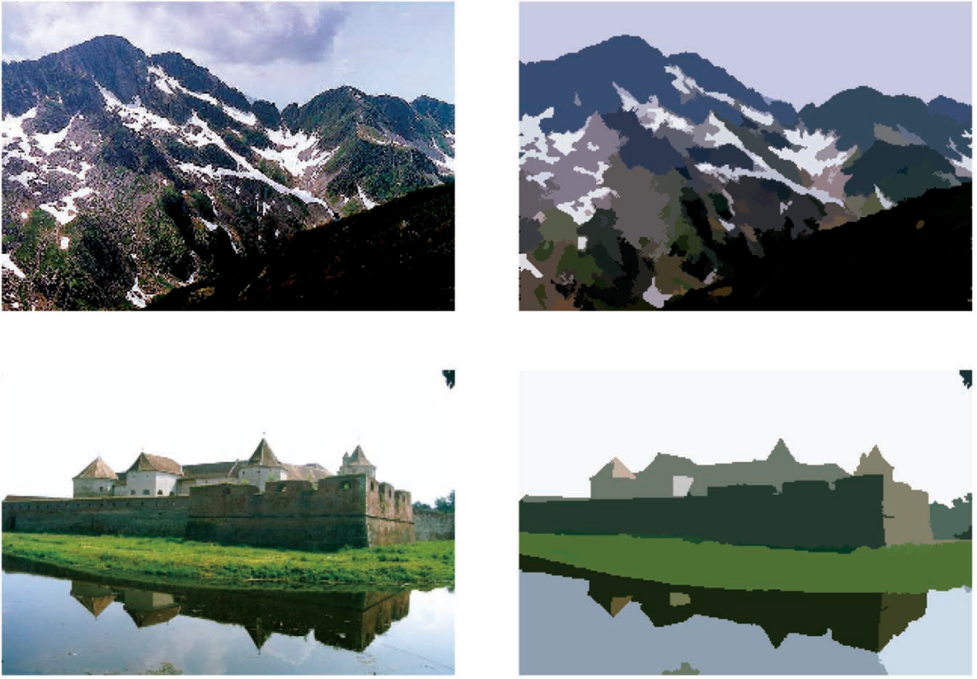
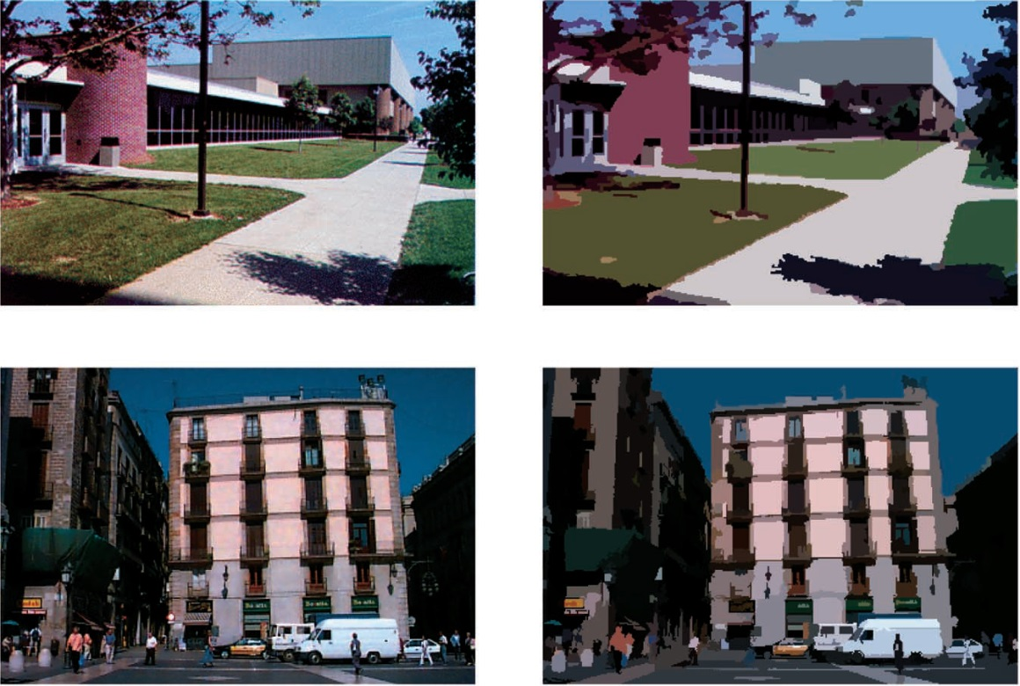
Segmented Images: each segment is assigned a single color. In this example, that color happens to be the average color of all pixels that belong to that segment. Such a segmented image looks like a cartoon!
Images
https://courses.csail.mit.edu/6.869/handouts/PAMIMeanshift.pdf

Slide 4
Applications of Image Segmentation
In medical imaging: Location of special types of tissues such as tumours and measuring their geometric properties such as perimeter/area/volume.
Image editing: Replacing a segment representing a particular entity by some other pattern or entity.
Object detection: examples include people or vehicles in traffic videos, or roads/water-bodies/vegetation in satellite images, or fruits/vegetables in images of orchards/farms.

Slide 5
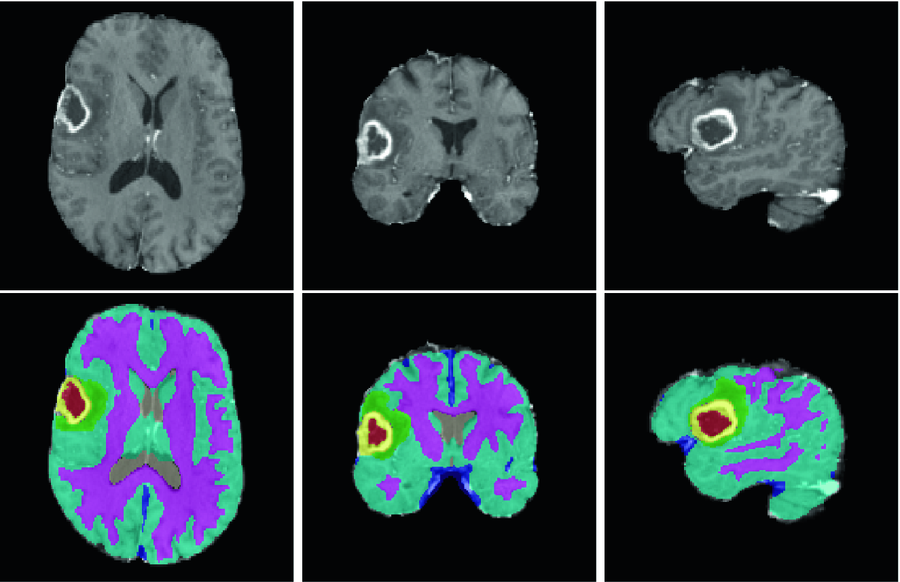
https://link.springer.com/chapter/10.1007/978-3-030-11726-9_26

Slide 6
Questions concerning segmentation
How to define similarity between pixels? If based on color, which color space? If not color, do we pick gradients or second derivatives or something else?
How many segments will the image consist of?
* Extreme case (1): The entire image is one segment (called under-segmentation).
* Extreme case (2): Every pixel is a separate segment (called over-segmentation)
* Both these extremes are generally undesirable!

Slide 7
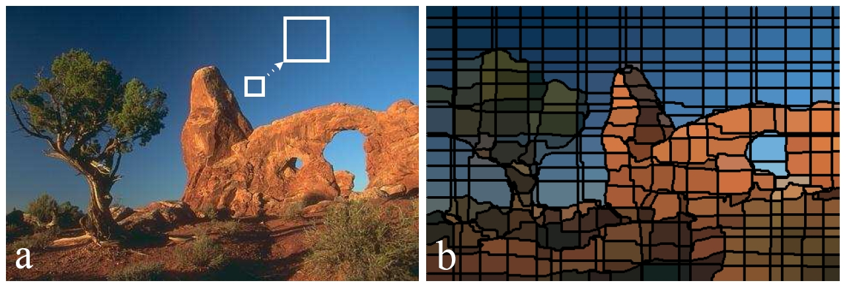
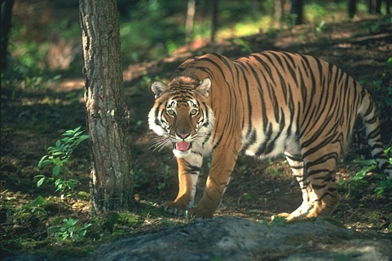
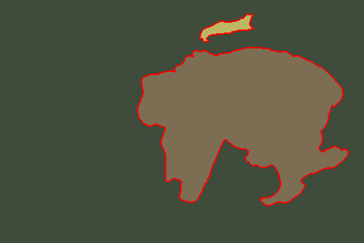
Example of over-segmentation!
Example of under-segmentation!

Slide 8
Segmentation approaches
There exist two major approaches to image segmentation: one of them is statistical, the other is geometric.
We will look at two statistical approaches in this course.

Slide 9
Segmentation as clustering
Clustering is a concept in (unsupervised) machine learning.
Given a set of N data-points {q₁,q₂,…,q_{N}} each in some d dimensions, it aims to group them into disjoint sets called as “clusters”.
There are a gazillion techniques for clustering (eg: k-means, fuzzy k-means, mixture models, mean shift, etc.).
Out of these, we will mainly study two techniques: k-means and mean shift.

Slide 10
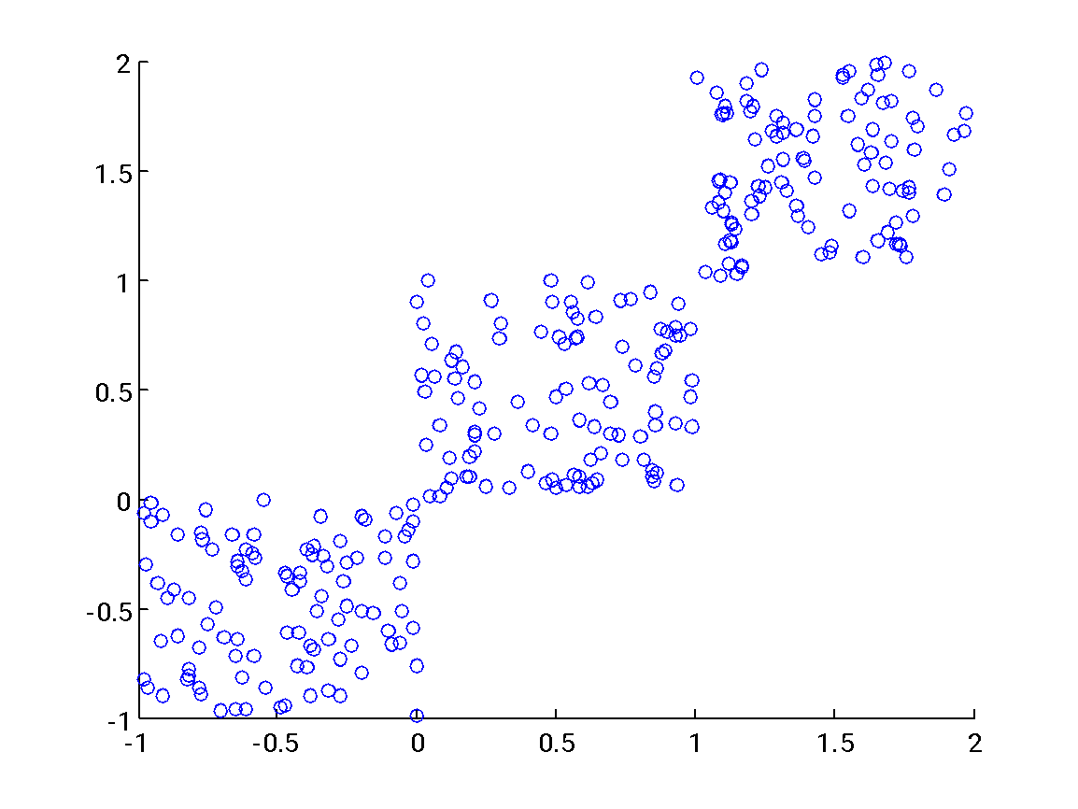
Cluster 1
Cluster 2
Cluster 3

Slide 11
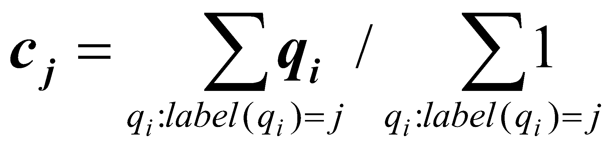
K-means
Animation for k-means: http://shabal.in/visuals/kmeans/3.html, http://www.youtube.com/watch?v=5FmnJVv73fU
Input: N data-points: {q₁,q₂,…,q_{N}}.
Output: A set of K clusters, such that each point q_{i} ϵ R^{d} (1 ≤ i ≤ N) belongs to exactly one cluster C_{j} (1 ≤ j ≤ K, K << N).
Method:
Pick K = the number of clusters (guessing the “right” K is a difficult problem).
Define K cluster centers (called centroids) {c₁,c₂,…,c_{K}} where each center is a point in R^{d}. Initialize them to random values.
For every q_{i} , find its closest (in terms of sum squared distance) c_{j} and assign it the label ‘j’. Do this for every point q_{i}.
Re-compute all the K cluster centers as follows:
Repeat steps 3 and 4 above, for a fixed number of iterations, or until the cluster center values don’t change much (called as a convergence criterion).

Slide 12
Variants of k-means
Use some other distance measure instead of Euclidean (i.e. sum of squared) distances.
Instead of finding centroids, find medoids.
Fuzzy k-means, where a point has a fuzzy degree (between 0 and 1) of belonging to a cluster.
Use fast data structures to speed up the search for the closest centroid.
Gaussian mixture models: each cluster is represented by a Gaussian probability density function (pdf), where the mean of the Gaussian pdf coincides with the cluster centroid. Assignments of points to clusters are not deterministic, but probabilistic.

Slide 13
K-means and Image segmentation
For each pixel location (x_{i},y_{i}), create a feature vector q_{i} = (x_{i},y_{i},R(x_{i},y_{i}),G(x_{i},y_{i}),B(x_{i},y_{i})) in case of color images, or (x_{i},y_{i},I(x_{i},y_{i})) in case of gray-scale images.
Perform k-means on these feature vectors. For an image with N pixels, there will be N feature-vectors to be clustered. Each feature vector is 5-dimensional for a color image, or 3-dimensional for a grayscale image.
What will happen if we use (R(x_{i},y_{i}),G(x_{i},y_{i}),B(x_{i},y_{i})) as a feature vector?

Slide 14
But…K-means is problematic!
How to find a good K? Too small a K will lead to under-clustering, too large a K is very expensive and will lead to over-clustering.
Highly sensitive to the initial assignments of the centroid values.
Can be slow to converge, and in fact may converge to a “bad” assignment of clusters.

Slide 15
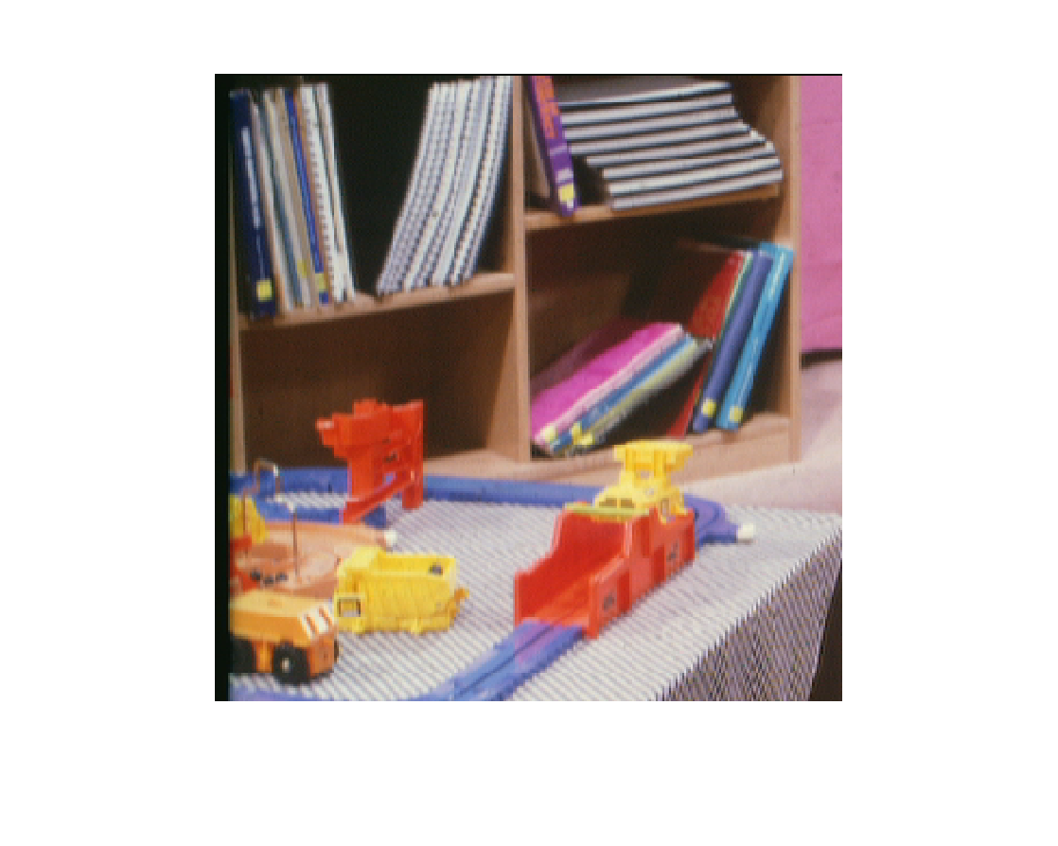
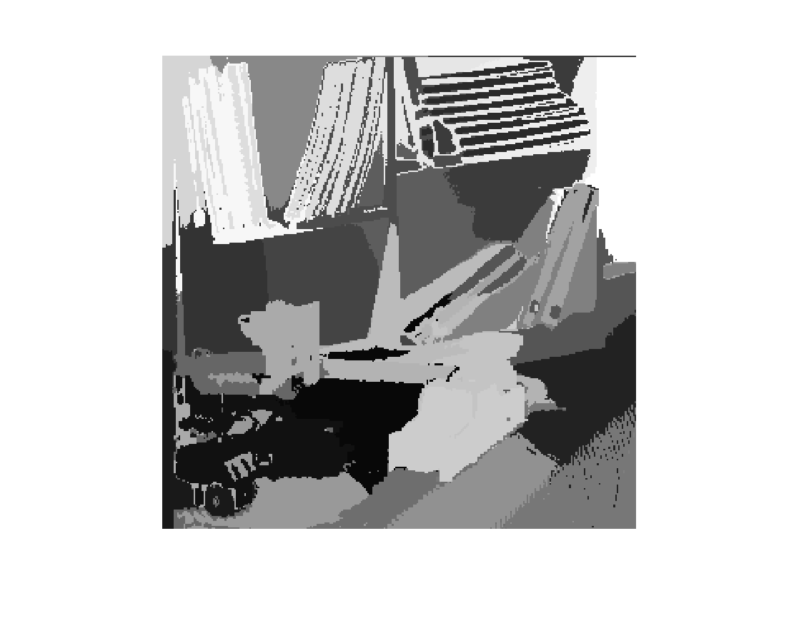
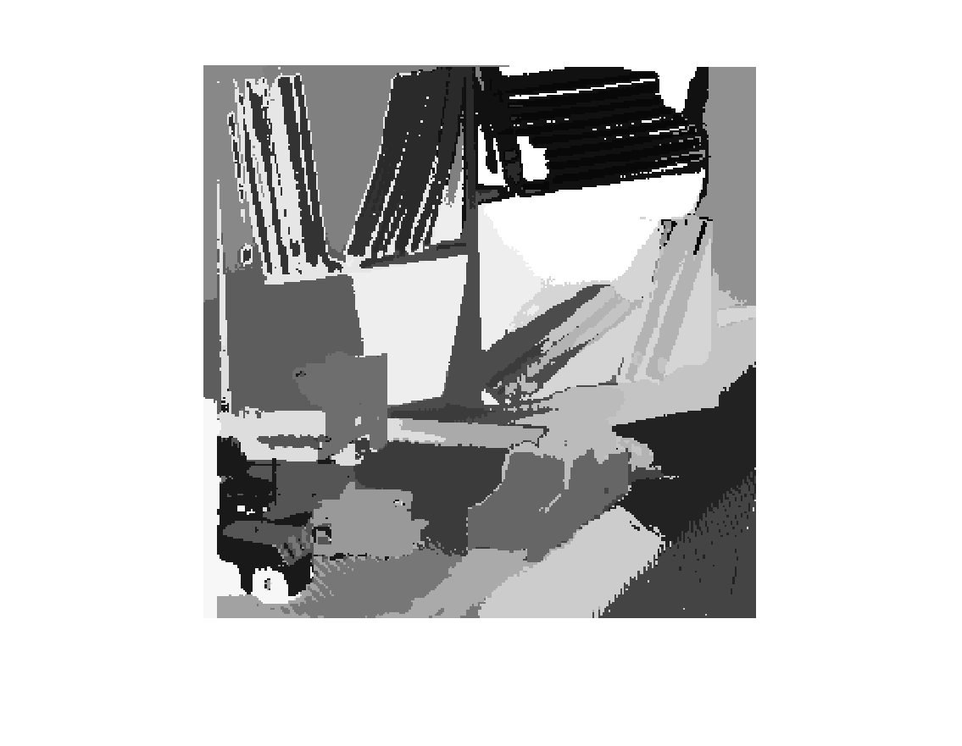
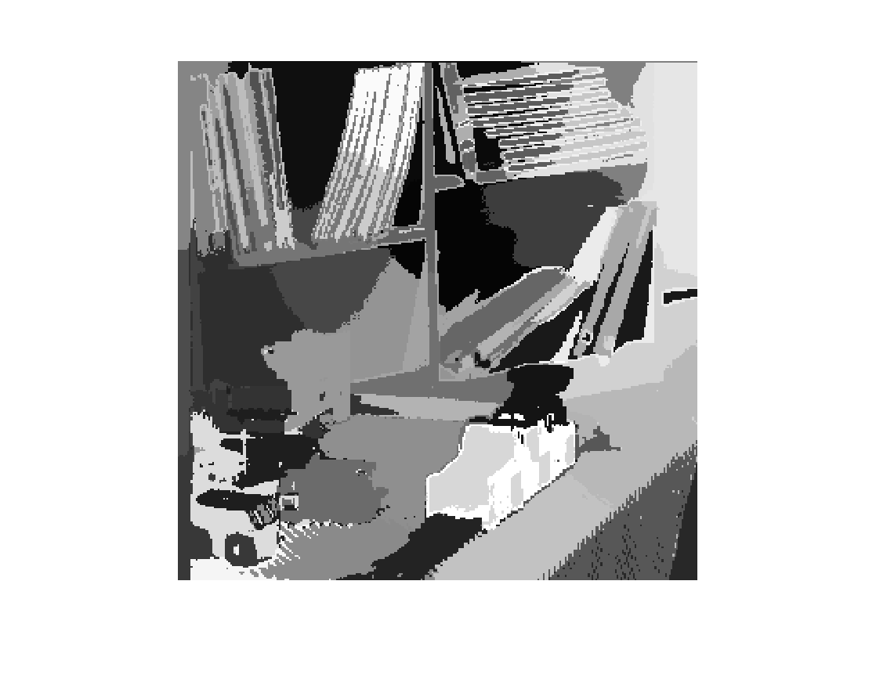
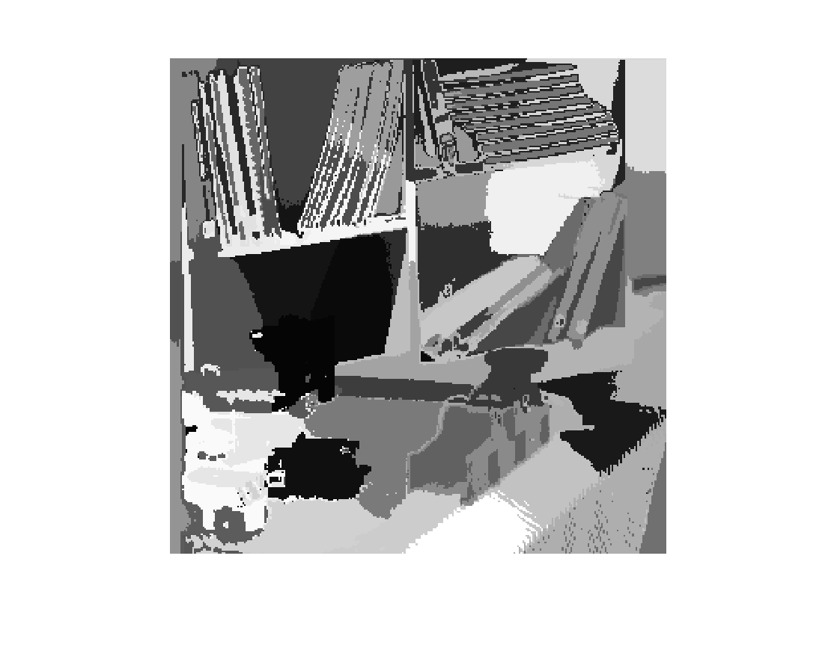
K = 30
K = 30
The segmentation results using K-means will vary if you chose different values of K. Even for the same K, you will get different results if you initialized the cluster centers differently.
K = 50
K = 50

Slide 16
Mean-shift
It is a technique that does not require you to pre-specify the value of K.
It gives you a mathematically clean and convenient to use convergence criterion.
It is heavily parallelizable.
It has shown success in so many image processing and computer vision applications!
To understand mean-shift, we need to understand an important machine learning concept – called probability density estimation, and in particular kernel density estimation.

Slide 17
Clustering and probability density functions
We can consider that the data points we want to cluster are samples from some (unknown) probability density function (pdf).
The underlying pdf is unknown, but given the samples, we can estimate it.
If we have more and more samples, our estimates will be more and more accurate.
It turns out (see next slide) that the cluster centers are modes (i.e. local maxima) of the pdf, i.e. they are points where the pdf has maximum value!

Slide 18
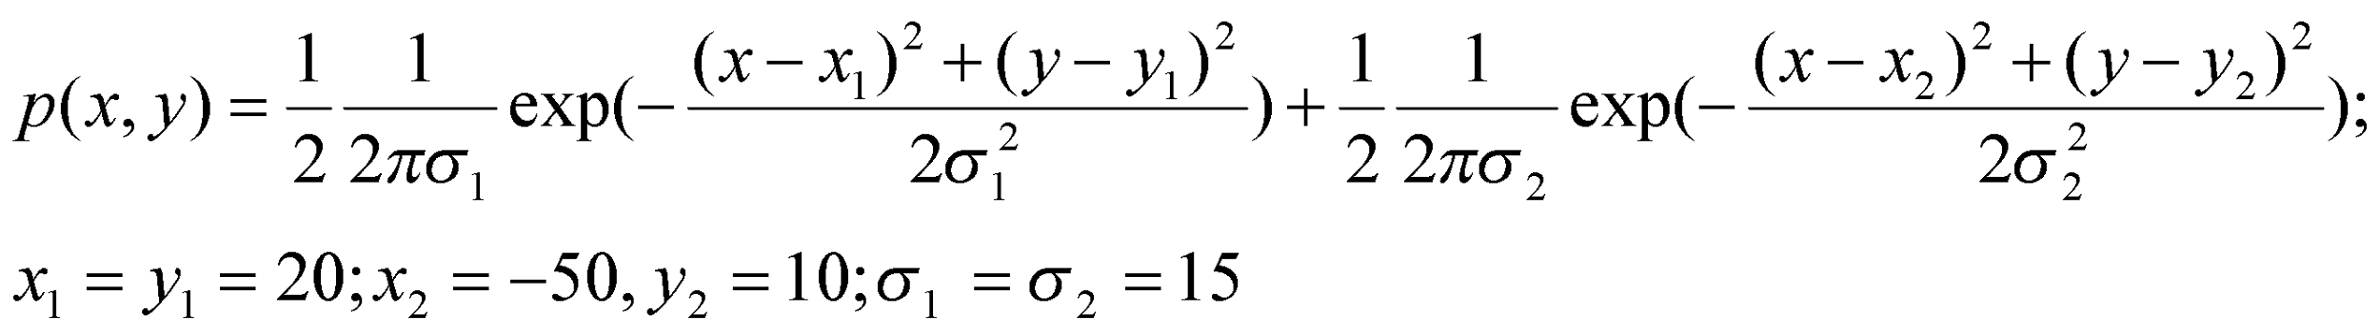
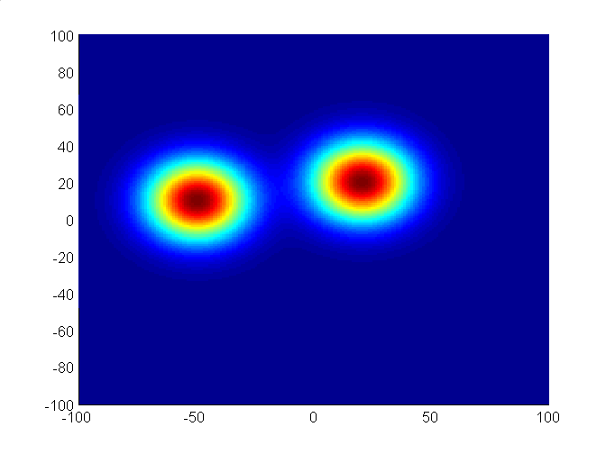
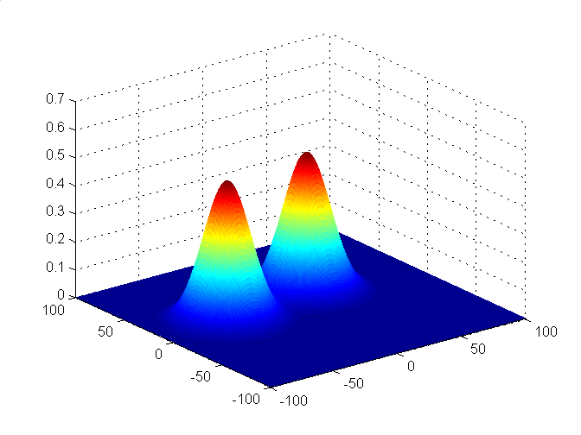
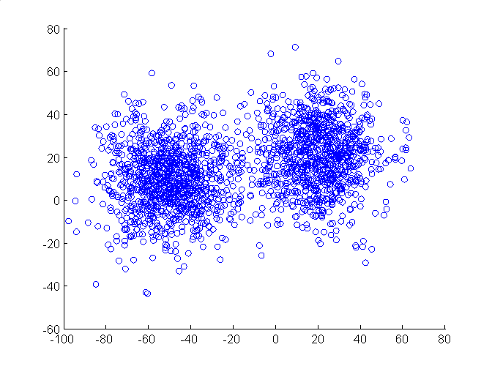
Samples from the above pdf plotted as a scatterplot in MATLAB. Notice the modes of the pdf and the cluster centers are the same.
Cluster center 1
Cluster center 2

Slide 19
Clustering and pdf’s
If we knew the pdf underlying the samples, we could identify the modes, and then our clustering is done.
But we DO NOT know the pdf.
So we need to estimate it using a method shown on the next few slides.
The great thing about the mean-shift algorithm is that it can identify the modes of the probability density efficiently. This will help us in image segmentation.

Slide 20
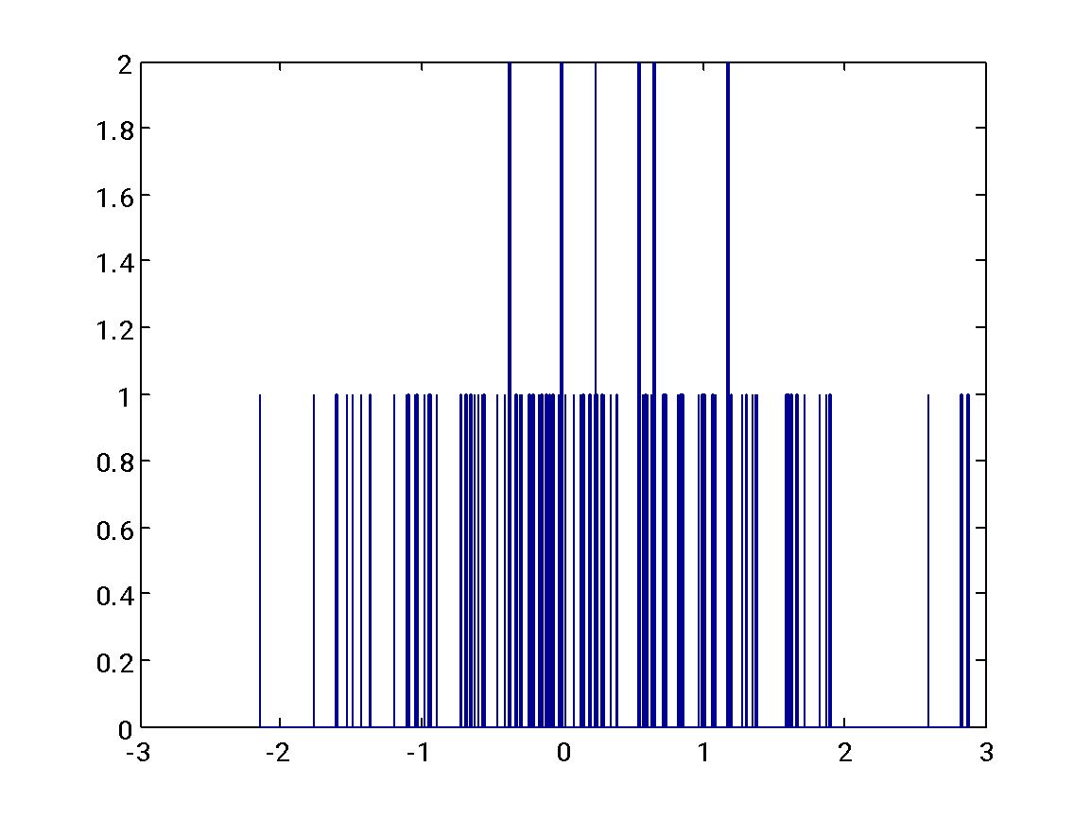
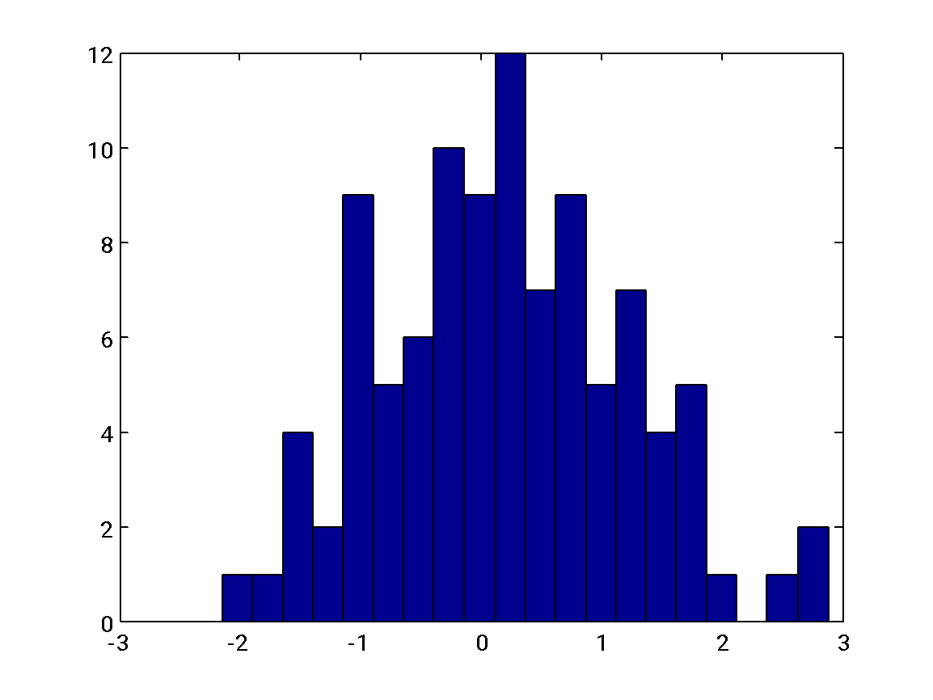
Histograms
Consider a set of N samples, {x₁,x₂,…,x_{N}}, with x_{i} ϵ R^{d} (1 ≤ i ≤ N). We want to estimate the underlying pdf.
The most well-known method to estimate the pdf is the histogram.

Slide 21
Histograms
Computing a histogram is equivalent to putting individual samples into boxes (see figure on the previous slide).
The optimal binwidth is O(N^{-1/3}), i.e. the optimal number of bins is O(N^{1/3}).
The error between the true pdf and its estimate via the histogram converges at the rate O(N^{-2/3}).
Problems with the histogram:
(1) picking the bin width (i.e. width of the box kernel) – equivalently the number of bins,
(2) discontinuity of the density estimate, i.e. sudden change in estimate if the location of the bin is slightly perturbed.

Slide 22
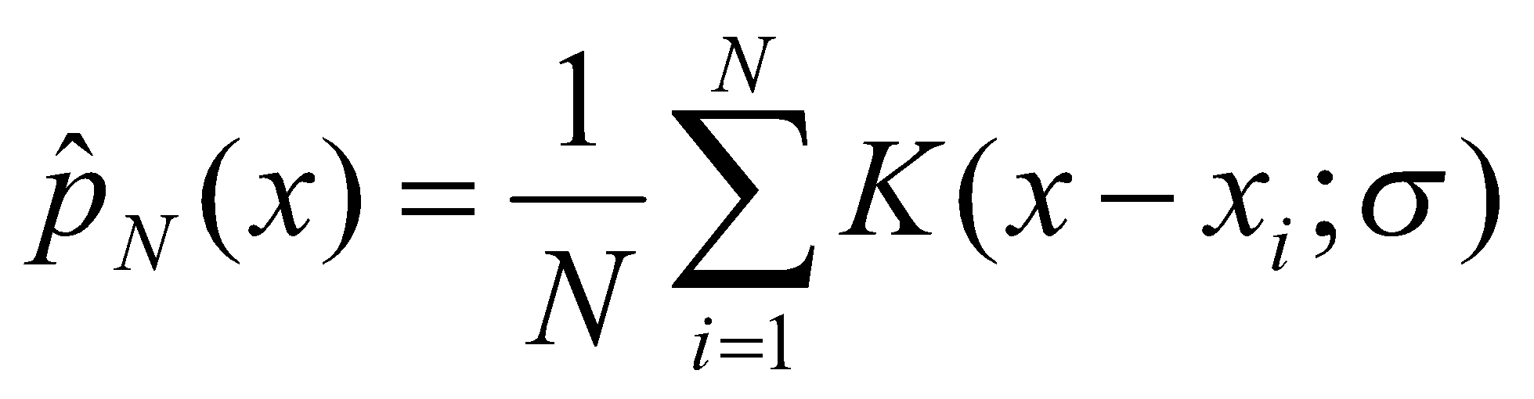
Kernel density estimates
This is equivalent to putting a smoothing kernel around each sample point (no need for binning).
The overall equation for a kernel density estimate (KDE) in 1-D is:
This stands for the i-th sample. There are totally N samples.

Slide 23
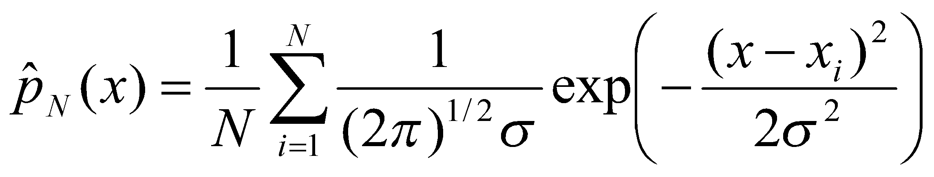
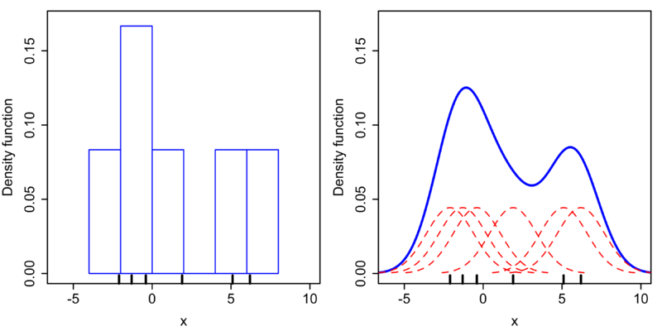
Kernel density estimates
If we choose a Gaussian kernel in 1D, the equation looks like:
Comparing a histogram with a Gaussian kernel density estimate. See how we are putting a Gaussian function around each sample (marked with a small vertical line in the figure on the right)

Slide 24
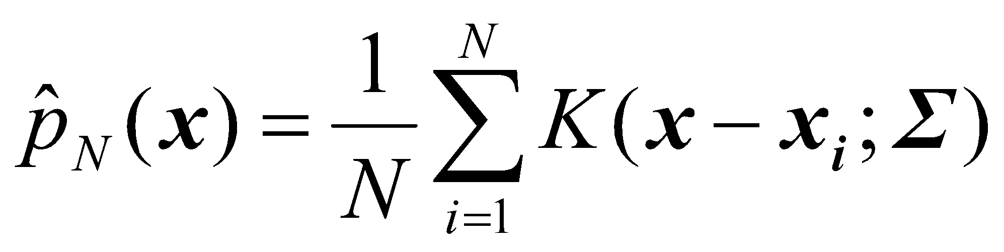
Kernel density estimates
The overall equation for a kernel density estimate (KDE) in higher (i.e. d > 1) dimensions is:

Slide 25
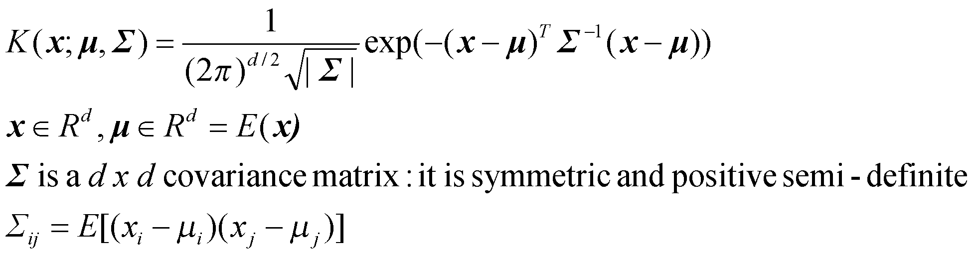
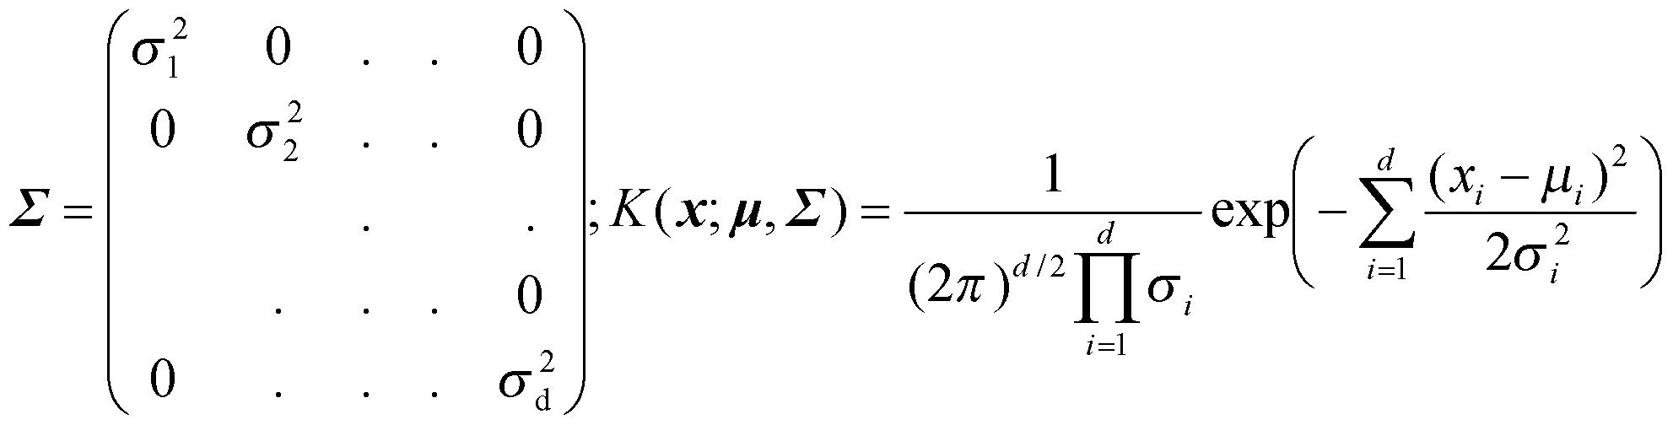
Gaussian Kernel in higher dimensions
The Gaussian kernel in higher dimensions is given as:
Sometimes a diagonal covariance matrix is used:
Here x_{i} stands for the i-th element of vector x

Slide 26
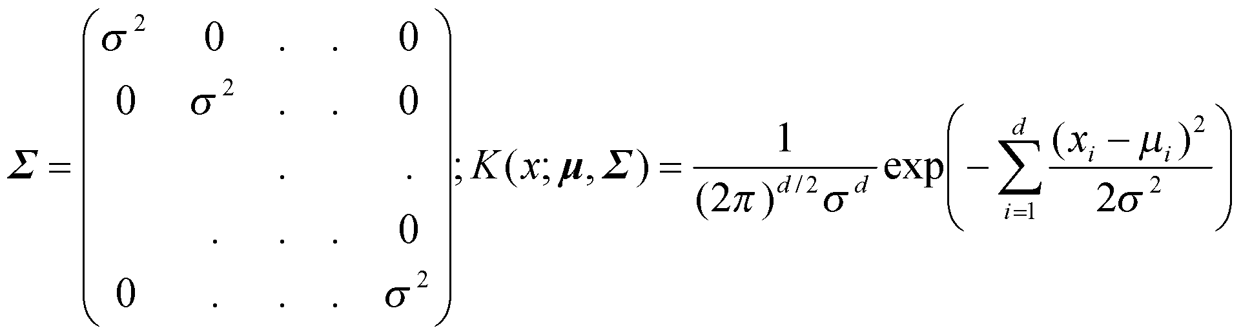
Gaussian Kernel in higher dimensions
Going one step further, a fully isotropic covariance matrix is sometimes used for simplicity:

Slide 27
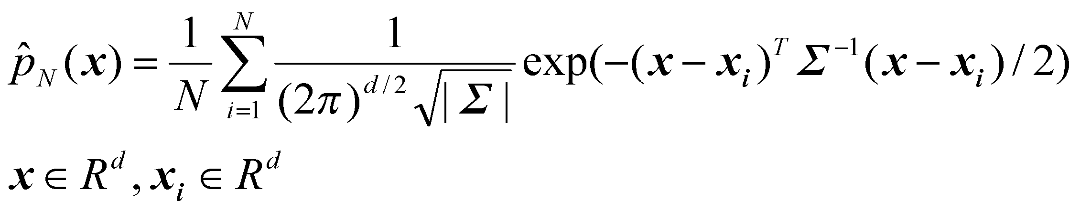
Gaussian Kernel in KDE
With the Gaussian kernel, the equation for a kernel density estimate (KDE) is:

Slide 28
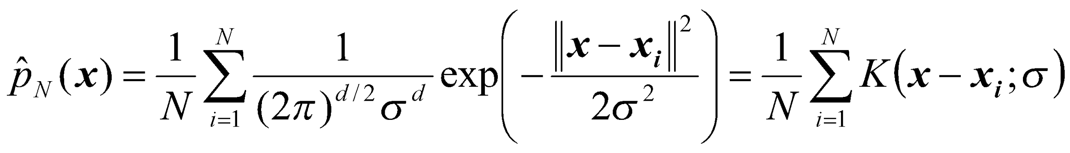
Gaussian Kernel in KDE
If we choose an isotropic Gaussian kernel, the equation for a kernel density estimate (KDE) is:

Slide 29
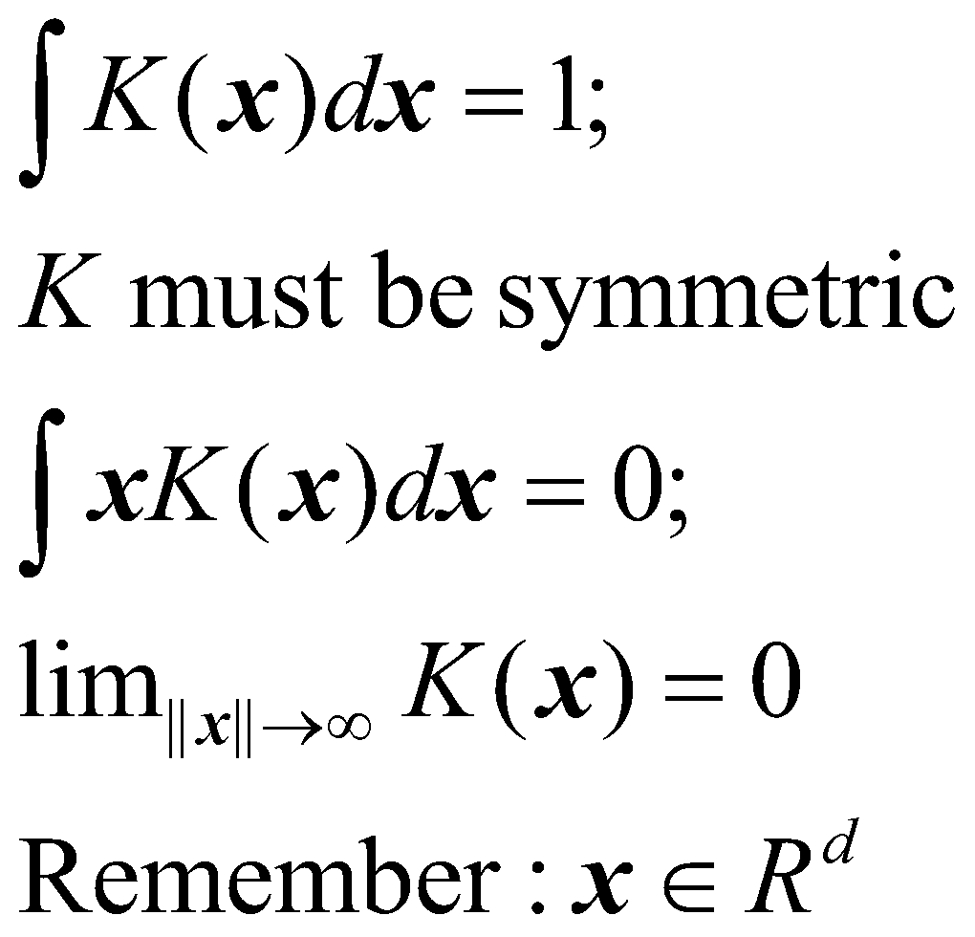
Other kernels in KDE
Apart from Gaussian kernels, other types of kernels can also be used.
The kernel must satisfy:

Slide 30
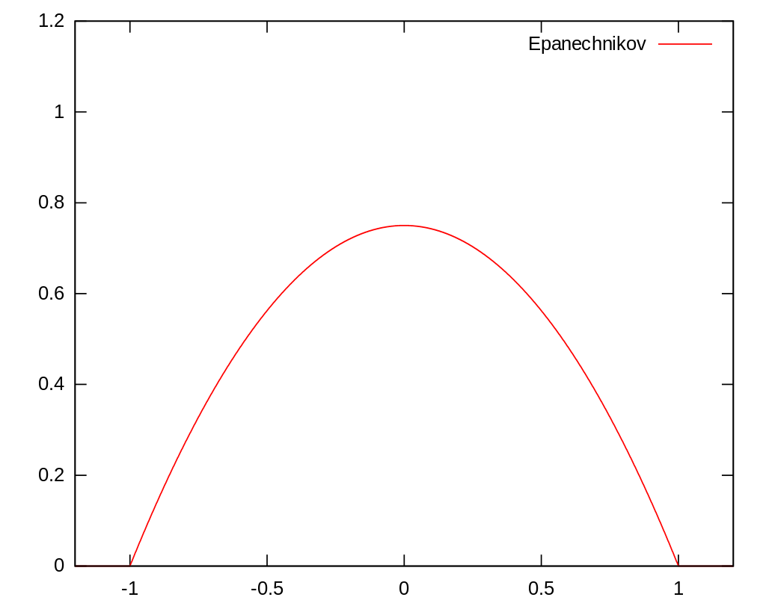
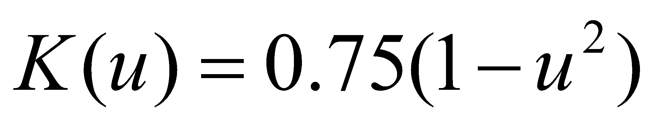
Other kernels in KDE
Epanechnikov (parabolic):
https://en.wikipedia.org/wiki/Kernel_(statistics)

Slide 31
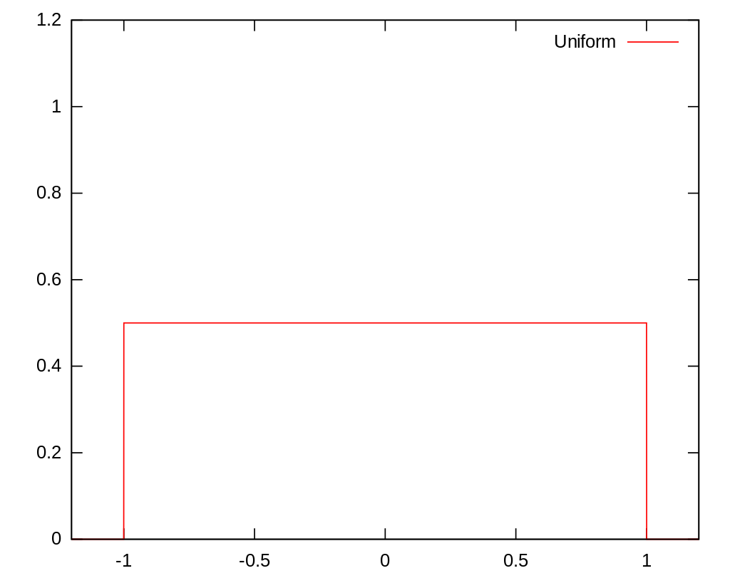
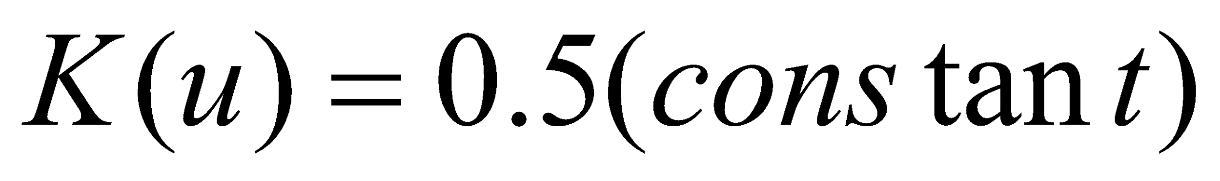
Other kernels in KDE
Uniform:
https://en.wikipedia.org/wiki/Kernel_(statistics)

Slide 32
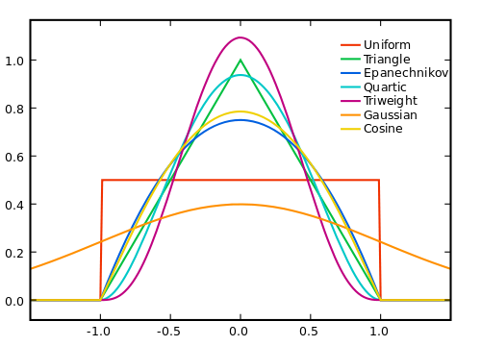
Other kernels in KDE
https://en.wikipedia.org/wiki/Kernel_(statistics)

Slide 33
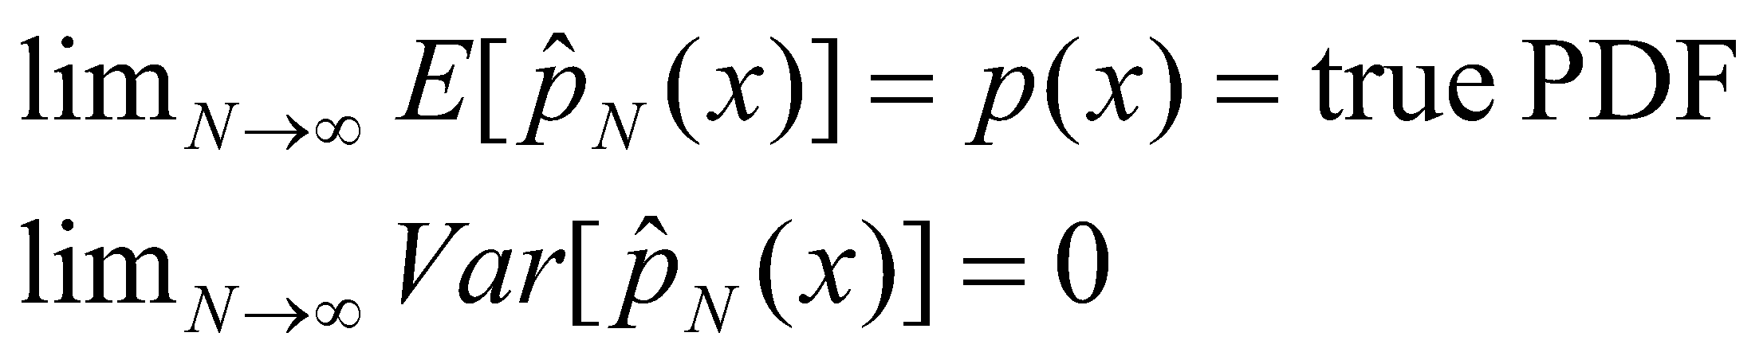
Kernel density estimates
Whether we are using histograms or KDEs, these are all (non-parametric) estimates of the true underlying pdf.
We have the following properties:
http://faculty.washington.edu/yenchic/18W_425/Lec6_hist_KDE.pdf

Slide 34
Kernel density estimates
For Gaussian and some other kernels, it has been proved that as the number of samples (i.e. N) tends to infinity, the kernel density estimate becomes more accurate and the error rate is O(N^{-0.8}) in 1D (in general O(N^{-4/(4+d)}) for d dimensions), provided that the kernel widths σ tend to 0 at a rate slower than N⁻¹.
This was proved by Emmanuel Parzen in a classic paper in 1952. Hence KDE is sometimes also called Parzen windows.
These estimates have better error rate than simple histograms which converge at the rate of O(N^{-0.667}) in 1D (in general O(N^{-2/(2+d)}) for d dimensions).
KDEs are also smoother than histograms. Unlike histograms they are also differentiable everywhere.
For these reasons, KDEs are preferred over histograms in many applications.
http://faculty.washington.edu/yenchic/18W_425/Lec6_hist_KDE.pdf

Slide 35
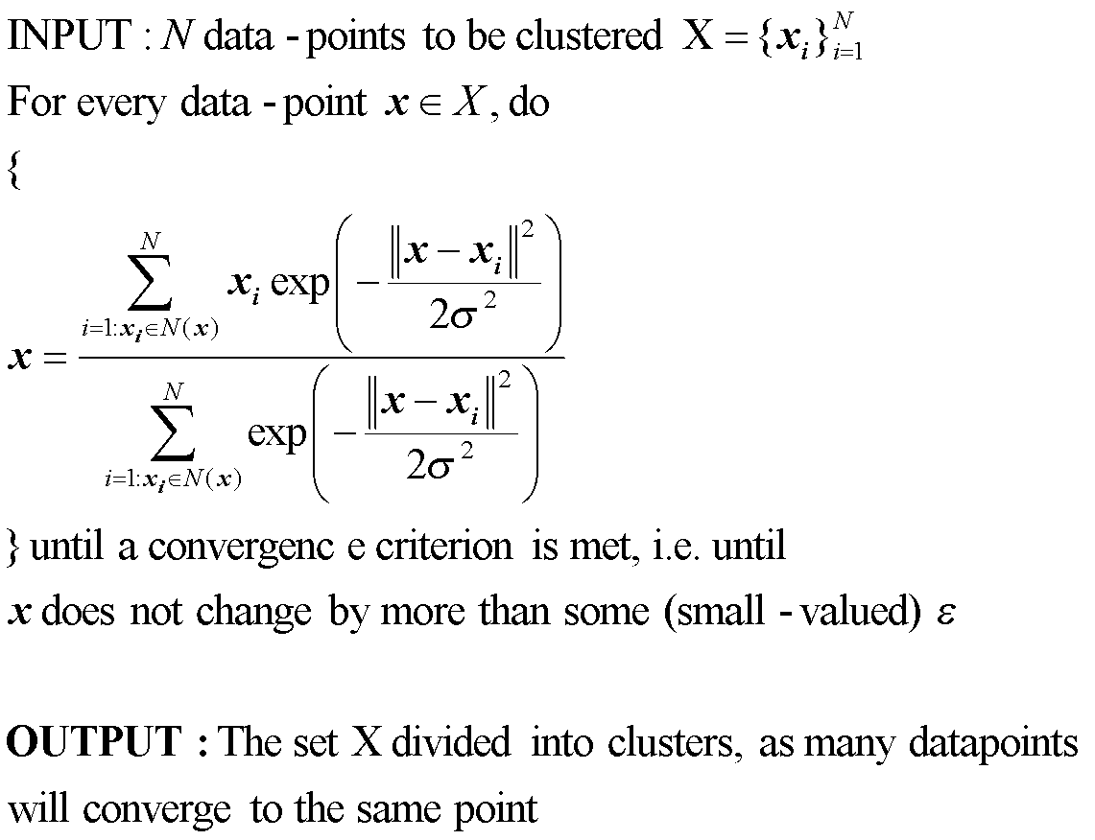
Mean shift algorithm
We will see the motivation for this algorithm on the next several slides.
Small neighborhood around the point

Slide 36
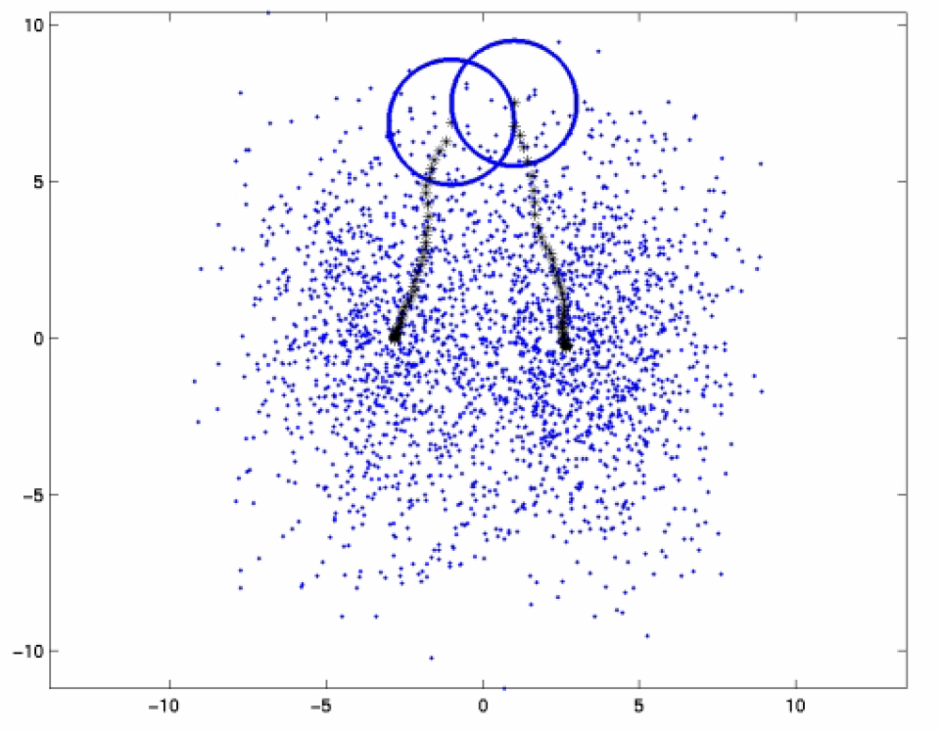
Mean shift
Mean-shift mode finding
Source: web tutorial on mean-shift- http://homepages.inf.ed.ac.uk/rbf/CVonline/LOCAL_COPIES/TUZEL1/MeanShift.pdf

Slide 37
Mean Shift Demos
http://www.youtube.com/watch?v=kmaQAsotT9s
http://www.youtube.com/watch?feature=player_detailpage&v=M8B3RZVqgOo#t=2275

Slide 38
Mean shift algorithm
In the mean-shift method, for each sample x_{i} we want find the closest mode (of the pdf estimated from all the N samples {x_{i}}).
For this, we perform a gradient ascent, i.e. we move in the direction of grad(p(x_{i})) [which is the direction of greatest increase in the density], starting from x_{i}.

Slide 39
Mean shift is like climbing in a range of mountains. Each sample climbs onto its nearest mountain ☺
p(x)
x₁
x₅
x₄
x₃
x₆
x₂
x

Slide 40
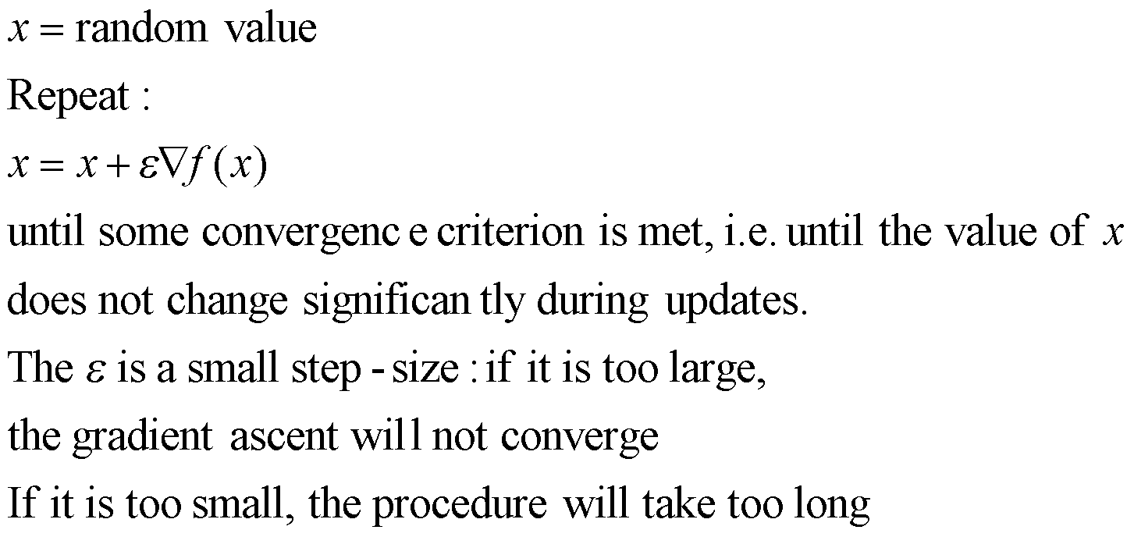
Digression: Gradient ascent
Suppose we want to maximize a function f(x) w.r.t. x.
The procedure for the same is given below:

Slide 41
Digression: Gradient ascent
In practice, we use an adaptive step-size.
That is, we start with a large value of ε.
If that value leads to an updated x for which f(x) does not increase, we reduce the value of ε by some factor (maybe 0.9 times the earlier value) – until you get an increase in the value of f(x).

Slide 42
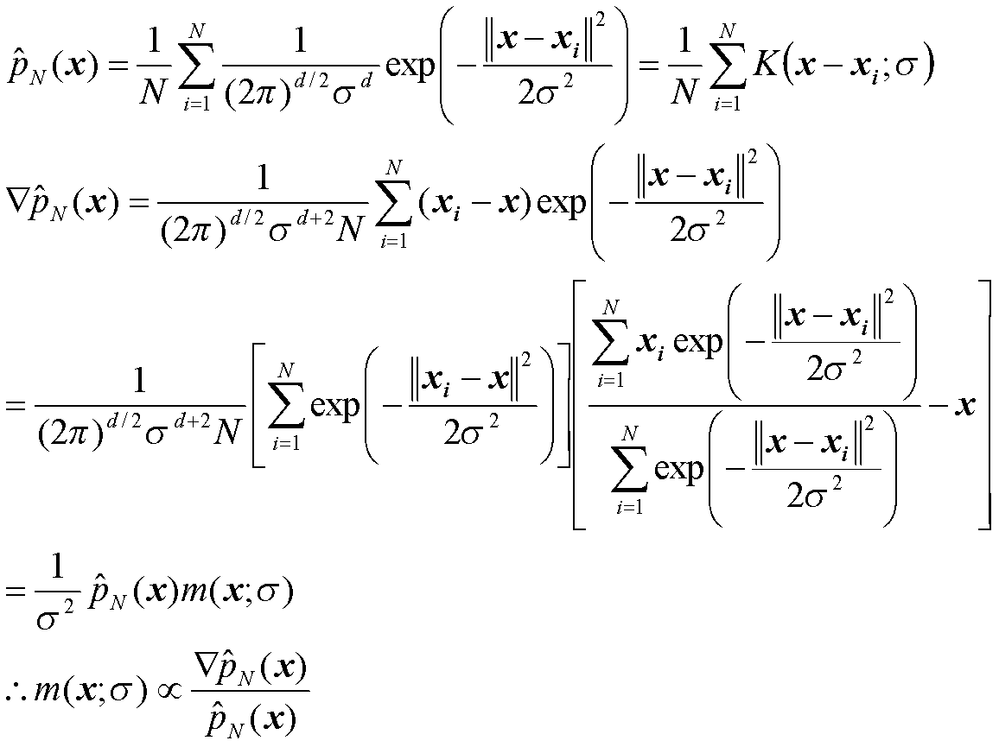
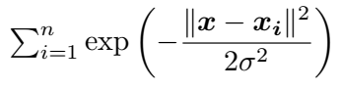
Mean-shift
Divide and multiply by the following
Mean shift vector – the first term is the weighted mean of all the samples

Slide 43
Mean shift
Notice the mean-shift vector points in the same direction as grad(p_{N}(x_{i})).
So we can move in the direction of the mean shift vector!
Mean-shift is a form of adaptive gradient ascent. We don’t need to pick the step-size, it comes in automatically.
In low-density regions, i.e. where p(x) is low, mean-shift moves very fast (why?). In higher density regions, it moves slowly.
These mean-shift based gradient updates have been shown to converge to the local mode, with monotonic increase in the PDF all along. (Theorem 1 of this paper.)
Although, we have shown derivations for the Gaussian kernel, these properties of mean shift and the mean shift vector are true for any kernel which satisfies the aforementioned properties.

Slide 44
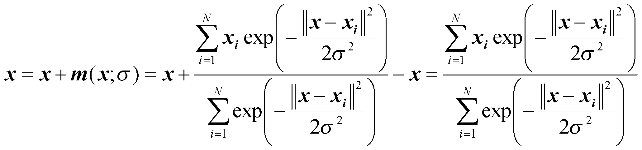
Mean shift for clustering
Here is how the mean shift algorithm works:
(1) Given a datapoint x, compute the mean shift vector m(x;σ).
(2) Translate the point using the mean shift vector, i.e. x = x + m(x;σ).
(3) Repeat steps 1 and 2 until convergence, i.e. until the value of x does not change very much. When that happens, we have reached a local mode of the pdf.
(4) Repeat steps 1, 2 and 3 for every sample point x.

Slide 45
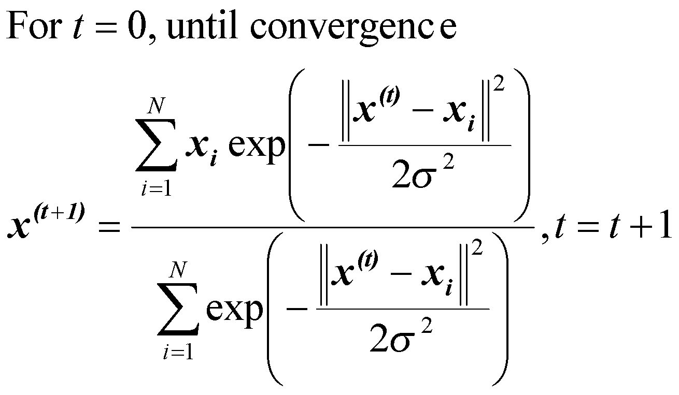
Mean shift for clustering
Equation for mean shift iteration in step (3) on the previous slide:
At the end of the procedure (i.e. after step (4)), we are left behind with all the maxima (modes) of the underlying pdf.
If you carefully go through the algorithm, you don’t even need to estimate the full pdf. You only estimate mean shift vectors!
Note: this procedure is guaranteed to converge in a finite number of iterations (in practice, as few as 10-20 iterations). The proof of convergence can be found in the paper by Comaniciu and Meer.

Slide 46
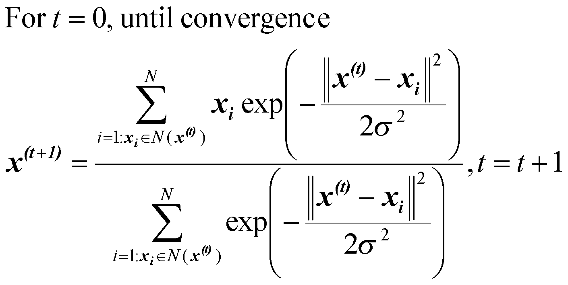
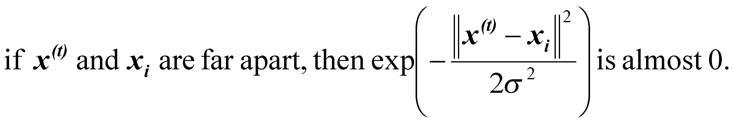
Mean shift for clustering: speed-up
In practice, the summations are computed only over those samples that in a pre-defined neighborhood around the point being updated.
This does not affect the results, because:

Slide 47
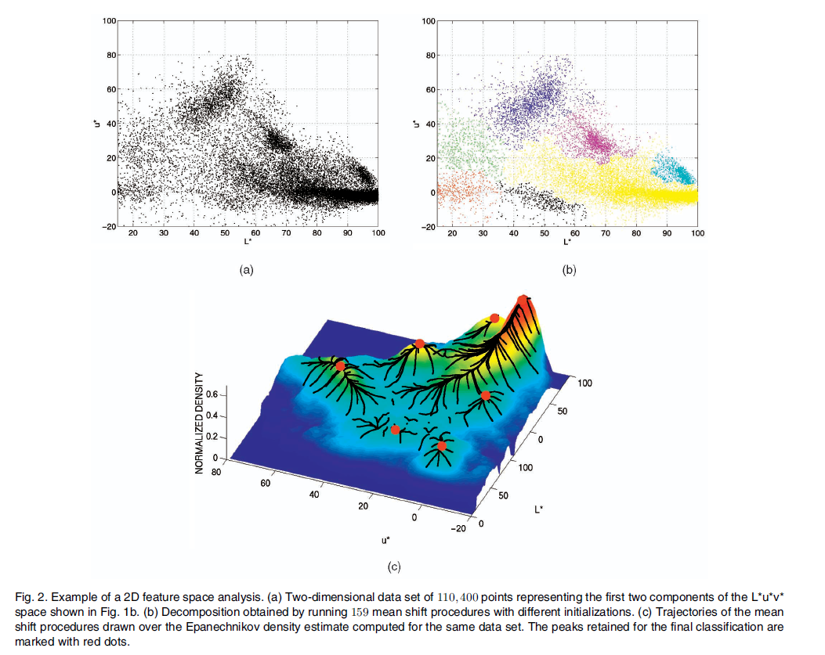
Source: The paper “Mean shift: a robust approach towards feature space analysis”,
By Dorin Comaniciu and Peter Meer, IEEE Trans. PAMI, 2002
https://courses.csail.mit.edu/6.869/handouts/PAMIMeanshift.pdf

Slide 48
Mean shift for image smoothing
Consider a color image with N pixels. For each pixel (x_{i},y_{i}), define the feature vector v_{i}=(x_{i},y_{i},R(x_{i},y_{i}),G(x_{i},y_{i}),B(x_{i},y_{i})).
(1) Run the mean-shift procedure until convergence, starting from v_{i}.
(2) Let the point to which the procedure converged, i.e. the mode of the pdf, be denoted by (x’,y’,R’,G’,B’).
(3) Replace the intensity values at (x_{i},y_{i}) by (R’,G’,B’).
Repeat steps 1,2,3 for all (x_{i},y_{i}).
Note: many different pixels (x_{i},y_{i}) will converge to the same point, i.e. the same value of (x’,y’,R’,G’,B’).

Slide 49
Mean shift for image smoothing
The kernel densities for image smoothing are chosen to be Gaussian (other kernels are also possible, but their analysis turns out to be slightly more complicated).
Usually, we use separate smoothing parameters for the spatial coordinates x = (x,y) and the intensity values I = (R,G,B).
The smoothing parameters for x will be denoted as h_{s} and the smoothing parameter for I is denoted as h_{r}.

Slide 50
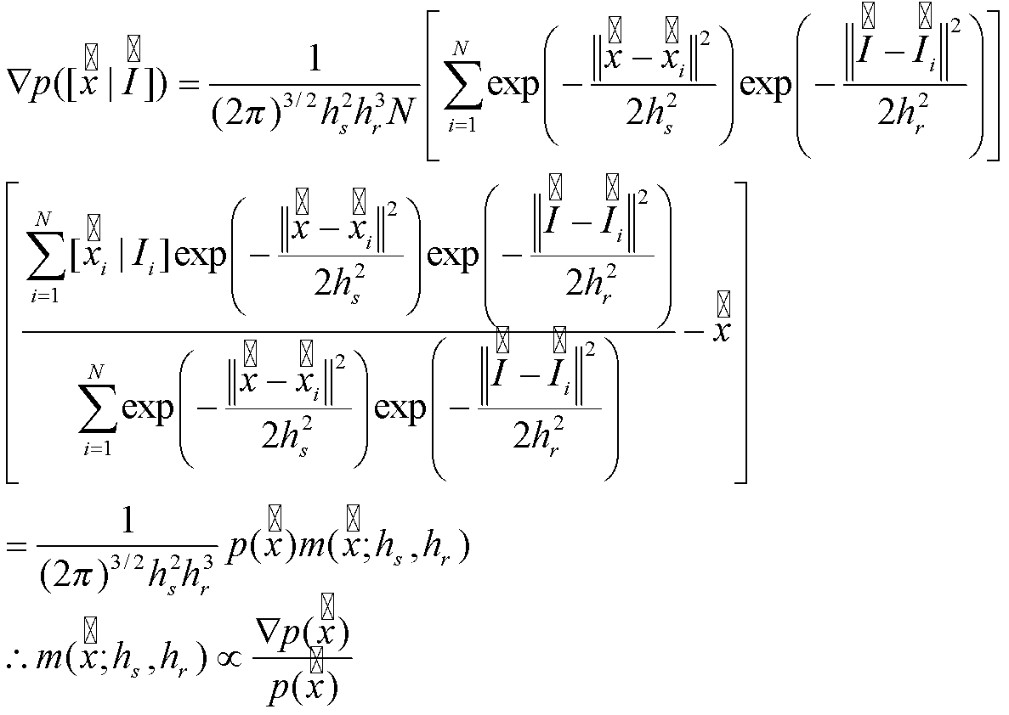
Mean shift for image smoothing
The mean shift vector under these assumptions looks as follows:

Slide 51
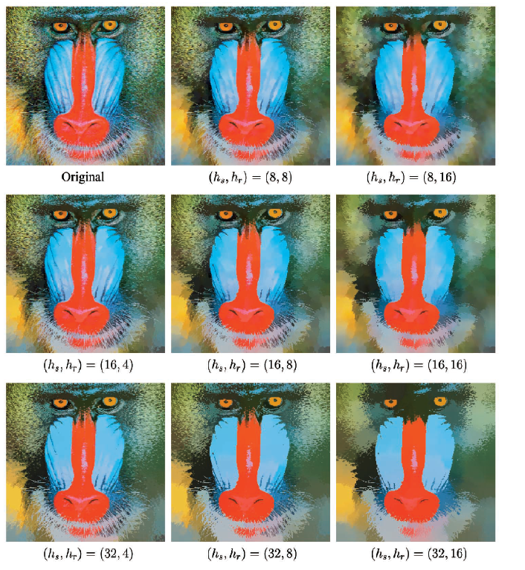
Source: The paper “Mean shift: a robust approach towards feature space analysis”,
By Dorin Comaniciu and Peter Meer, IEEE Trans. PAMI, 2002
https://courses.csail.mit.edu/6.869/handouts/PAMIMeanshift.pdf

Slide 52
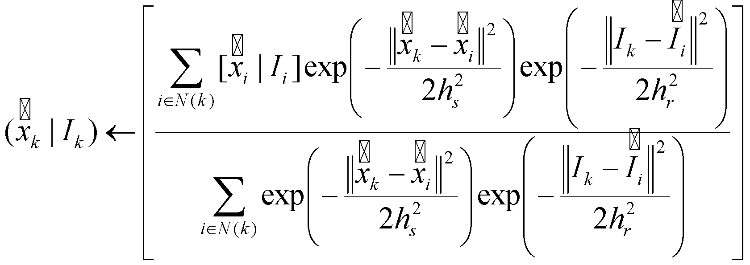
Mean shift for smoothing
For each pixel k, do the following until convergence:
Use these values of I_{k} in the smoothed image.
Let the value to which (x_{k},I_{k}) converged be called z_{k}.

Slide 53
Mean shift and bilateral filtering
You would have (should have) noticed the similarity between mean shift and bilateral filtering.
Mean shift is an iterated version of bilateral filtering where the number of iterations of smoothing varies from pixel to pixel, and this number is always chosen automatically by the mean shift procedure itself!

Slide 54
Mean shift segmentation
Perform mean-shift filtering using parameters h_{s} and h_{r}, on the given image (say f(x,y)) to give you a filtered image g(x,y).
Assign all those pixels that converged to the same point (say z_{k}), to one and the same segment!
Merge together all z_{k} which are closer than h_{s} in spatial domain and closer than h_{r} in intensity domain into a single cluster.

Slide 55
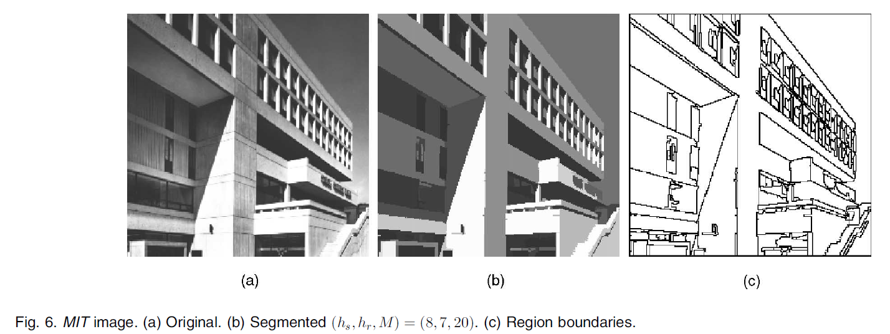
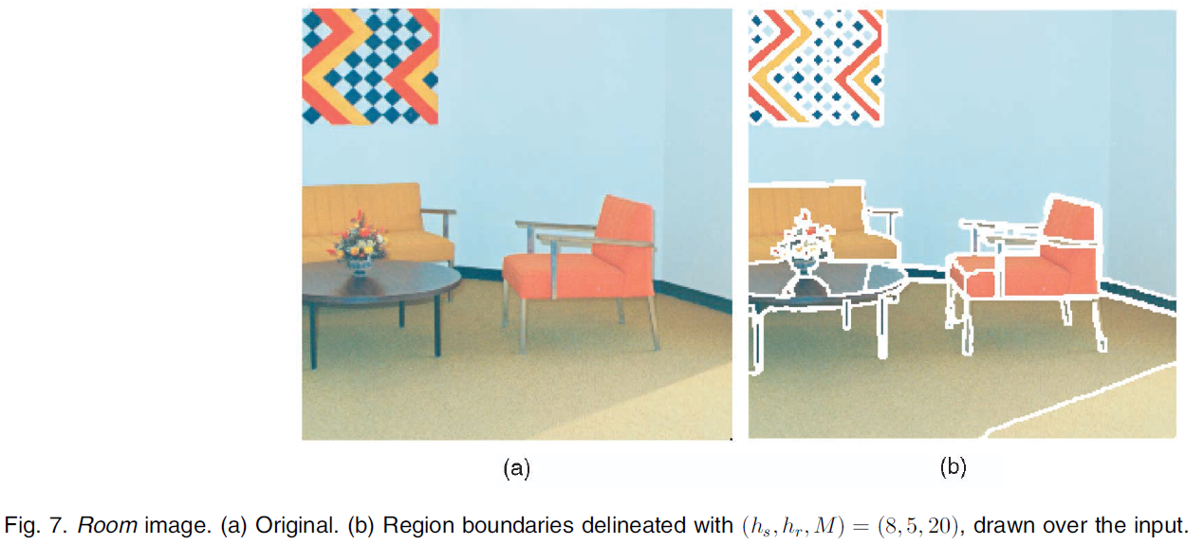
https://courses.csail.mit.edu/6.869/handouts/PAMIMeanshift.pdf

Slide 56


https://www.ipol.im/pub/art/2019/255/article_lr.pdf

Slide 57

https://www.ipol.im/pub/art/2019/255/article_lr.pdf

Slide 58
References
This topic is not present in the book. You can refer to the following online tutorials:
http://homepages.inf.ed.ac.uk/rbf/CVonline/LOCAL_COPIES/TUZEL1/MeanShift.pdf
http://en.wikipedia.org/wiki/Mean-shift
OR one of the following papers (which are not meant for the faint-hearted ☺)
“Mean shift: a robust approach towards feature space analysis”, by Dorin Comaniciu and Peter Meer, IEEE Trans. PAMI, 2002.
Fukunaga, Keinosuke; Larry D. Hostetler (January 1975). "The Estimation of the Gradient of a Density Function, with Applications in Pattern Recognition". IEEE Transactions on Information Theory (IEEE) 21 (1): 32–40.
Cheng, Yizong (August 1995). "Mean Shift, Mode Seeking, and Clustering". IEEE Transactions on Pattern Analysis and Machine Intelligence (IEEE) 17 (8): 790–799

